Slide 1
Crystal Boy
By Ellie Ly and Corinna Yong

Slide 2
Objective
To create an interactive game revolving around the dangers of fossil fuels and how it affects the environment and consumers (I.e. Global Warming, Kerosene fume poisoning)
Make users aware of these dangers through lore and gameplay
Target audience: gamers and young adults

Slide 3
Plan -> Game
Ideally point and click
Use the arrow keys to move
Players move Crystal Boy through the level in order to collect the crystal on the map
Each level (called chapters) represents the destination of the crystals (where they will go to after avatar obtains them)

Slide 4
Plan -> Story
2D adventure puzzle game (story is prioritized over gameplay)
Player (Crystal Boy) has an objective to collect crystals for the sake of the Kingdom
The crystals contain special power that wizards can use to function the kingdom’s machinery and create certain products
Upon completion of a level in the game a cutscene plays depicting the crystal being put into use and the aftereffects of the crystals.
These cutscenes show the first the positive and immediate effects of the crystal and then show the long term and negative effects of using the crystal and crystal dust byproduct.

Slide 5
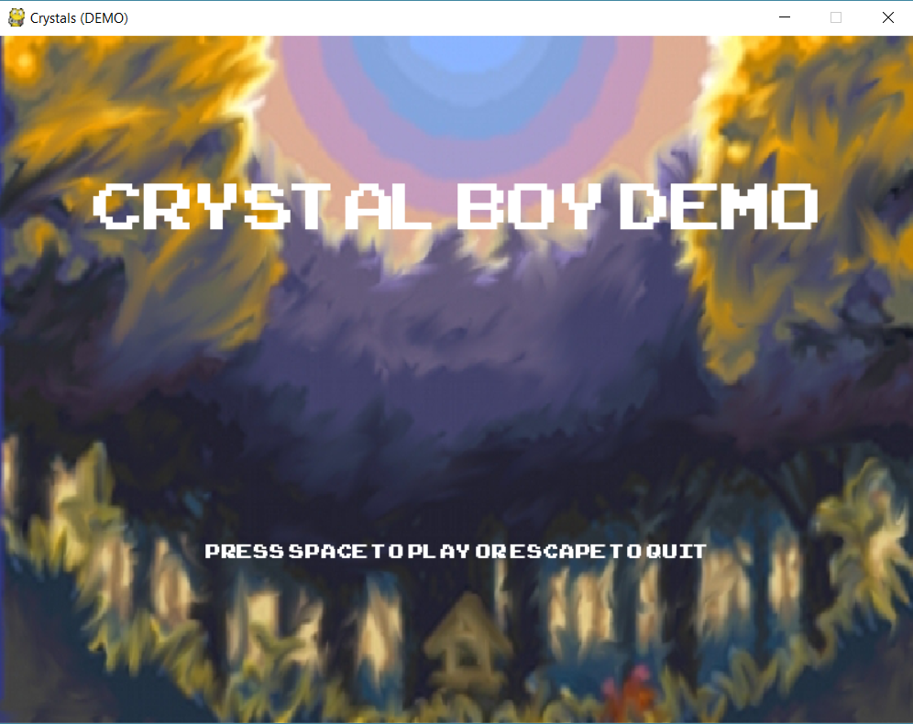
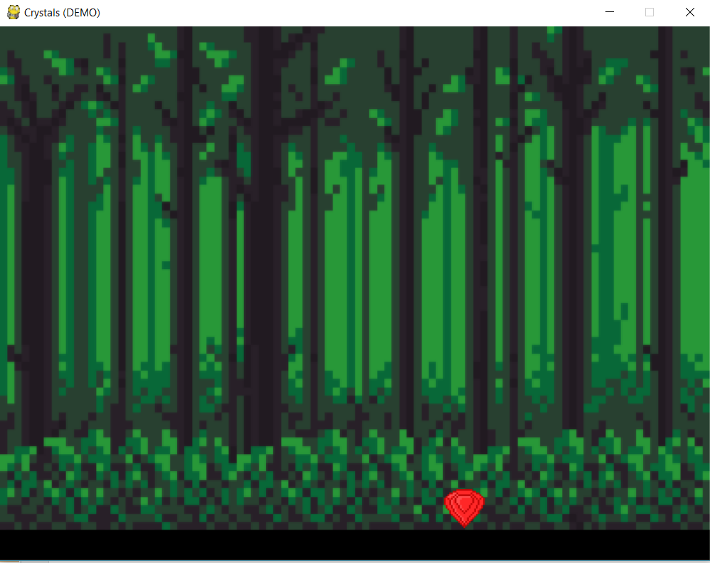
Demo

Slide 7
Bugs & Issues
Difficulty creating cutscenes & animations (Python does not take GIFs)
Character kept flickering (animation issue)
May be difficult to get the point/underlying theme across
Need more time to create more levels and for character development

Slide 8
Future Improvements/Suggestions
Use a different language to set up the game’s framework (C++, Java)
Include interactive objects (books with some text about fossil fuels, etc.)
Increasingly difficult platforms and include puzzles
More crystals and other possible items to collect (powerups, informational, etc.)
Sequels set in the same realm, but tackling a different issue (I.e. inequality, police (knight) brutality, health issues, etc.)

Slide 9
Conclusion
Thank you!

